Slide 1
Video Games and Their Effects on Society
By: Jordan, Chloe, Greyson, Maricela

Slide 2
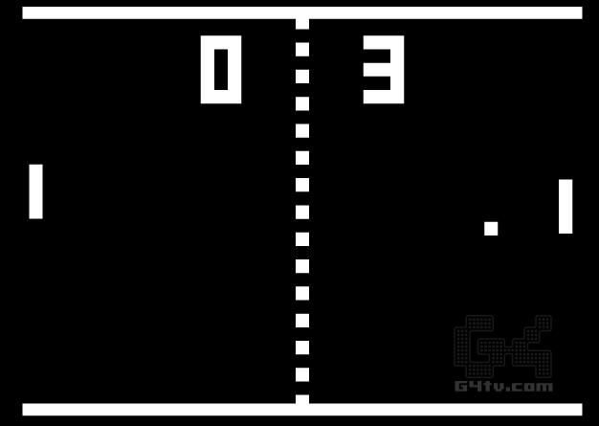
Where Did video games come from?
Video games started a long time ago (60 years to be more specific) they came and still have huge impacts on society today.
From programmers working in a lab trying to make their computers make funny lines move balls like tennis to now, where game designers make whole worlds to explore, they have come a very, very, long way.
This Photo by Unknown author is licensed under CC BY-SA-NC.

Slide 3
How have video games impacted society up to now?
Video games in all their glory have of course in their own way shaped our world, shaped how people think and of course shaped our kids' brains in their own (for bad or good) way.
To be a bit more specific video games have caused huge changes in the world, with huge communities forming around games whether a simple one like pong or a game like Skyrim people love passing the time by playing their favorite game and in this they have shaped our world simply by playing and enjoying games.
This Photo by Unknown author is licensed under CC BY-SA-NC.

Slide 4
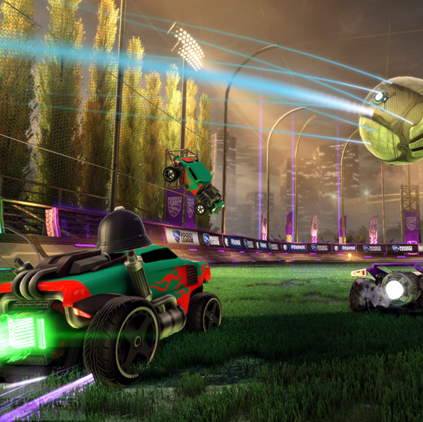
The Positive Effects of video games on people
Improved Cognitive abilities
Improved problem- solving skills and logic
Greater multi- tasking abilities
This Photo by Unknown author is licensed under CC BY-SA.

Slide 5
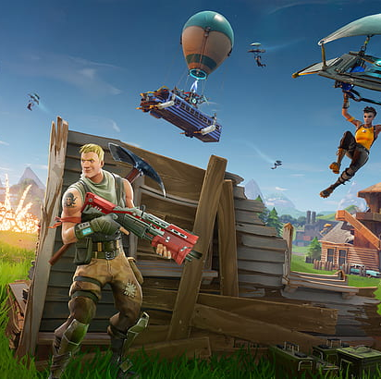
Diving deeper
When it comes to mastering the importance of spatial awareness, video games will do exactly this. By playing video games for a long period of time, an individual's brain will start to increase remembering and recognizing skills. This is beneficial when it comes to doing everyday tasks such as driving, using a map, and navigating your way through a state.
Majority of video games require strategic thinking and logic to operate the game, which therefore enhances development in areas of the brain used for problem solving and logic. Playing video games increases problem solving skills by increasing the gray matter and connectivity between the sub regions in the insular cortex.
Gamers must keep track of how much health they have left, ammo and other stats, all while having to control the character. This trains the brain by performing multitasking, which will be beneficial when it comes to completing daily task along with many other tasks at the same time.

Slide 6
The Negative Effects of Video Games in Society
The mental and physical concerns...
Obesity
Low femoral neck bone mineral density risk in adolescents
Short attention spans
Exposure to many inappropriate content
Lack of face-to-face social skills
Aggressive behaviors.

Slide 7
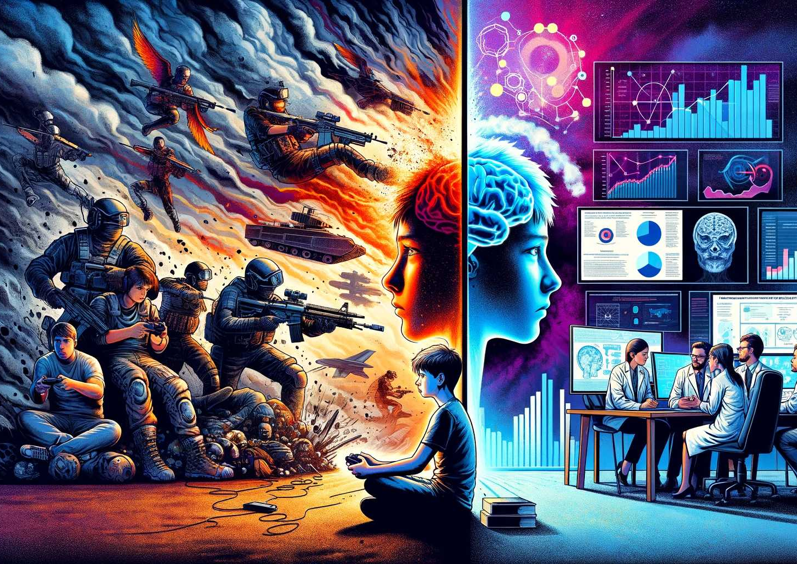
Understanding the Issues
Video games have ultimately become a public health issue all over the world increasing its average to about 3.05% = 60 million people world-wide with this issue.
Companies are making them more versatile and accessible with gaming by creating mobile apps to play on your phone. Unfortunately, because video games are so accessible with no warnings of graphics or what content may be shown, many children are exposed to violent and inappropriate graphics. Children who play violent video games become numb and desensitized to violence and even display aggressive behaviors
Online gaming users such as adults and teens can speak freely on whatever gaming devices or consul but are unaware that there may be a younger audience playing as well. This also, unfortunately, exposes kids to online predators, especially without adult supervision.

Slide 8
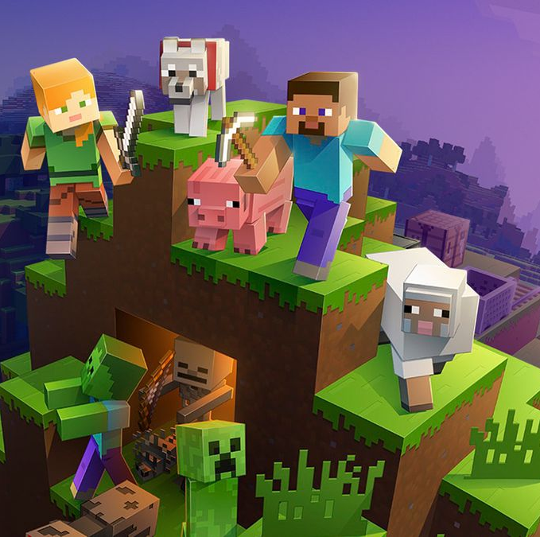
Video Games and Their Effect on the Future
Video games can cause people to lack basic social skills needed to talk and work with others.
Video games can also cause some people to develop social anxiety and avoid interactions all together.
Some video games can help people with their problem-solving skills and allows for teens to solve problems easily.
All these examples can affect someone's future both negatively and positively depending on what games they play.

Slide 9
Video Games and Their Effects on Society
Video games are often viewed to have negative effects on people, but they can also have positive effects
Video games have brought communities together
Video games can be used to cure boredom and entertain people
The amount of time people spend playing video games determines if the effects are positive or negative

